Slide 1
SERS-based Detection of Bacterial Biomarkers using Raman Spectroscopy
Review Meeting: 08th April 2026

Slide 2
Work Completed
1. Biomarker Identification
• Identified key bacterial biomarkers: N-acetylmuramic acid (NAM), LTA, LPS • Literature survey on Raman signatures
2. Sample Procurement
• NAM biomarker procured • Powder-based Raman experiments initiated
3. Software & Computational Setup
• Gaussian 16 software procured and installed • Computational environment configured
4. Training & Skill Development
• Attended training on Gaussian and DFT simulations • Learned molecular modeling and vibrational analysis
5. Initial Simulation Work
• DFT simulation workflow established • Rhodamine B used for method validation
6. Experimental Work (NAM)
• Raman spectra collected under multiple conditions • Data preprocessing and quality optimization performed

Slide 3



Meeting Agenda
Rhodamine B
NAM Detection
LTA
Comparative analysis assessing the accuracy of literature vs. present DFT methodologies against experimental values.
Experimental optimization and theoretical verification of the N-Acetylmuramic Acid bacterial biomarker.
Quantum chemical simulation and peak assignment also comparing with experiment data

Slide 4
Part I: Method Validation (Rhodamine B)
Comparative Analysis of Raman Frequencies of Rhodamine B Experimental vs Literature DFT vs Present DFT
Reference: Shuang Lin et al., Rapid and sensitive SERS method for determination of Rhodamine B in chili powder with paper-based substrates, RSC Advances
Your Method: Gaussian 16 – B3LYP / 6-31G(d)

Slide 5
Study Objective
Objective
To compare Raman vibrational frequencies of Rhodamine B obtained from:
Experimental Raman spectra (literature)
Literature DFT calculations
Present DFT calculations
Goal
Evaluate the accuracy and reliability of our computational method.

Slide 6
Computational Method Comparison
Study | Software | Functional | Basis Set
Literature DFT | Gaussian 09 | B3LYP | 6-31G
Present Work | Gaussian 16 | B3LYP | 6-31G(d)
Key Difference
Our work includes polarization functions (d) in the basis set.
Importance
Polarization functions improve the description of electron distribution and vibrational modes.

Slide 7
Raman Peak Comparison Overview
Three datasets were compared:
Experimental Raman Peaks
Literature DFT Values
Present DFT Values
Key vibrational modes analyzed:
Xanthene ring puckering
Aromatic C–C bridge stretching
C–H bending
Aromatic ring bending
C=C stretching

Slide 8
Xanthene Ring Puckering
Experimental | Literature DFT | Our DFT | Lit Deviation | Our Deviation
619 | 613 | 608.64 | 6 | 10.36
Aromatic C–C Bridge Stretch
Experimental | Literature DFT | Our DFT | Lit Deviation | Our Deviation
1193 | 1195 | 1196.16 | 2 | 3.16
C–H Bending Mode
Experimental | Literature DFT | Our DFT | Lit Deviation | Our Error
1275 | 1278 | 1273.92 | 3 | 1.08

Slide 9
Aromatic C–C Bending (~1355 cm⁻¹)
Our DFT | Experimental | Literature DFT
1334.40 / 1386.24 | 1354–1355 | 1355
Aromatic C–H Bending (~1500 region)
Our DFT | Experimental | Literature DFT
1489.92 / 1533.12 | 1504 / 1523 | 1504 / 1525
C=C Stretch (~1642 cm⁻¹)
Our DFT | Experimental | Literature DFT
1636.80 | 1642 | 1644

Slide 10
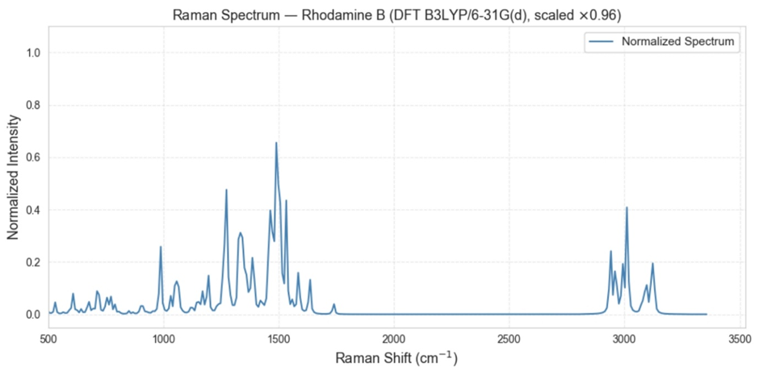
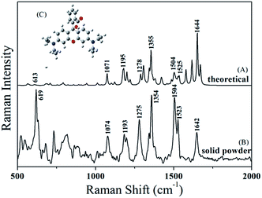
Conclusion
Both DFT methods reproduce major Raman bands of Rhodamine B.
Inclusion of polarization functions improves theoretical description but may introduce mode splitting.
Overall agreement confirms the reliability of our computational approach.
Raman Spectrum Obtained from Gaussian Simulation
Spectrum Taken from Literature

Slide 11

Part II: N-Acetylmuramic Acid
Experimental Optimization and Peak Assignment (NAM)

Slide 12

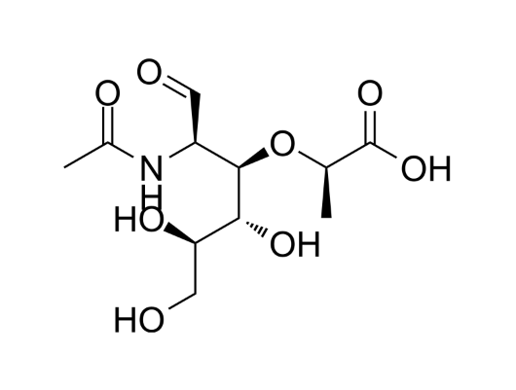
Raman–DFT Analysis of N-Acetylmuramic Acid (NAM)
Structural Importance
→
N-Acetylmuramic Acid (NAM) is a critical component of the peptidoglycan layer found in bacterial cell walls.
→
It links with N-acetylglucosamine (NAG) to form the structural carbohydrate backbone of the cell.
→
Because NAM is unique to bacteria, reliable spectroscopic detection serves as a definitive identifier of bacterial presence.

Slide 13
Raman + DFT Approach
Why Combine Raman with DFT?
Raman spectroscopy provides experimental peaks.
DFT simulations help to:
Predict vibrational frequencies
Assign functional groups
Validate spectral interpretation
Objective
Measure Raman spectrum of NAM
Simulate spectrum using DFT
Compare experimental and theoretical peaks

Slide 14
Chemical Sample
Compound: N-Acetylmuramic Acid (NAM)
Functional groups present:
Hydroxyl (–OH)
Ether (C–O–C)
Amide
Carboxylic acid
Pyranose ring
Property | Value
Molecular Formula | C11H19NO8
Molecular Weight | ~293 g/mol
Structure | Acetylated amino sugar

Slide 15
Experimental Method
Sample Preparation
NAM powder used
Measured in solid state
Advantages of powder samples:
Stable measurement
Strong Raman scattering
No solvent interference
Raman Measurement
Parameter | Range
Laser wavelength | 785 nm
Laser power | 10–80 %
Integration time | 10–25 s
Spectral range | 200–3000 cm⁻¹
DFT Simulation Parameters (NAM)
Software: Gaussian 16
Method: B3LYP / 6-31+G(d,p)
Calculation: Opt (Tight) + Freq (Raman)
Geometry: Connectivity defined
Resources: 16 cores, 56 GB RAM

Slide 16
Raman Data Processing
Spectra were preprocessed before analysis.
Processing pipeline:
Dark subtraction
Savitzky–Golay smoothing
Baseline correction (ALS)
Normalization
Peak detection
SNR calculation
Parameter | Value
Integration time | 25 s
Laser power | 80 %
Best SNR | 95.9
These settings produced the highest quality spectrum.

Slide 17
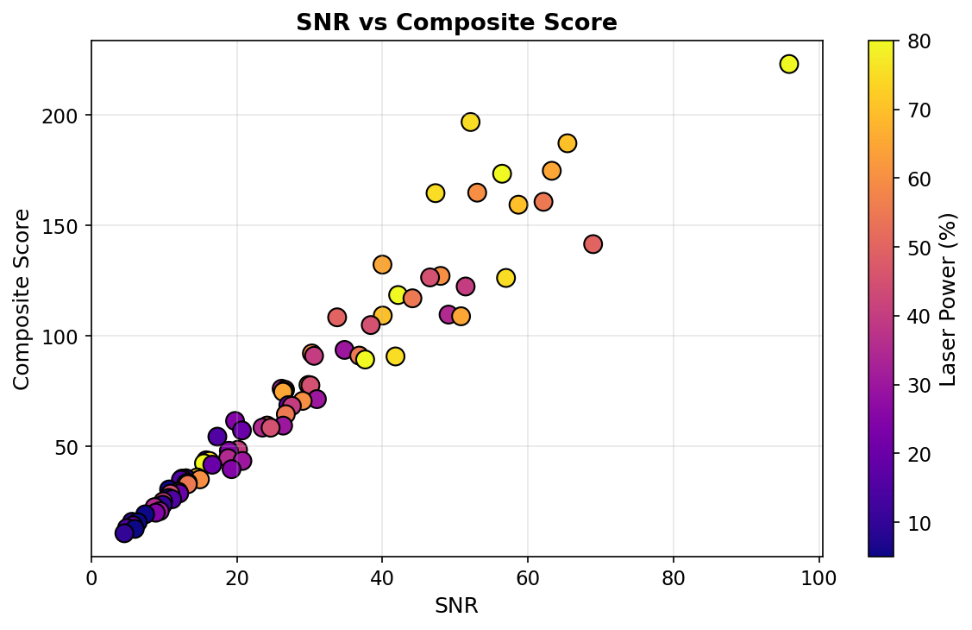
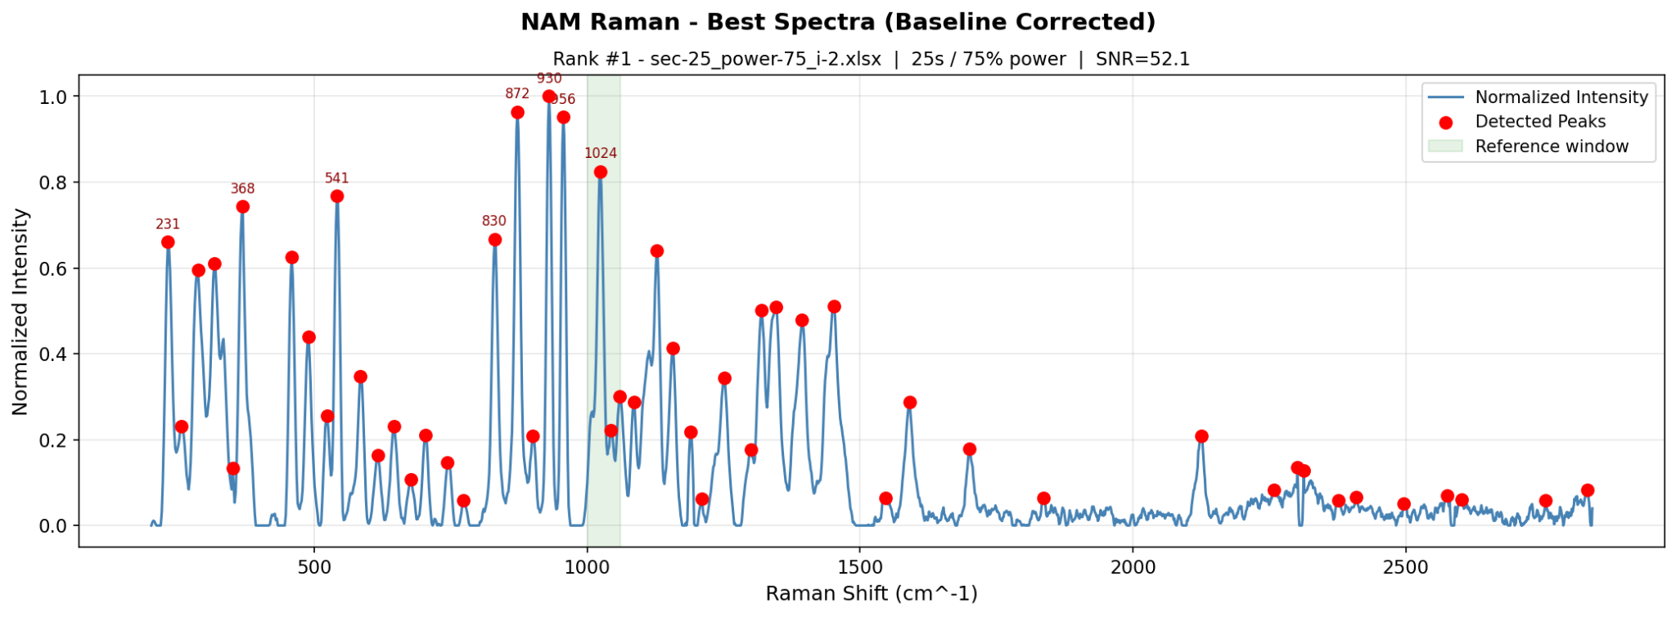
Optimal Raman Parameters
Parameter | Value
Integration time | 25 s
Laser power | 80 %
Best SNR | 95.9
> 80 = Excellent
These settings produced the highest quality spectrum.
SNR Interpretation:
>80 → Excellent
50–80 → Very Good
30–50 → Good

Slide 18
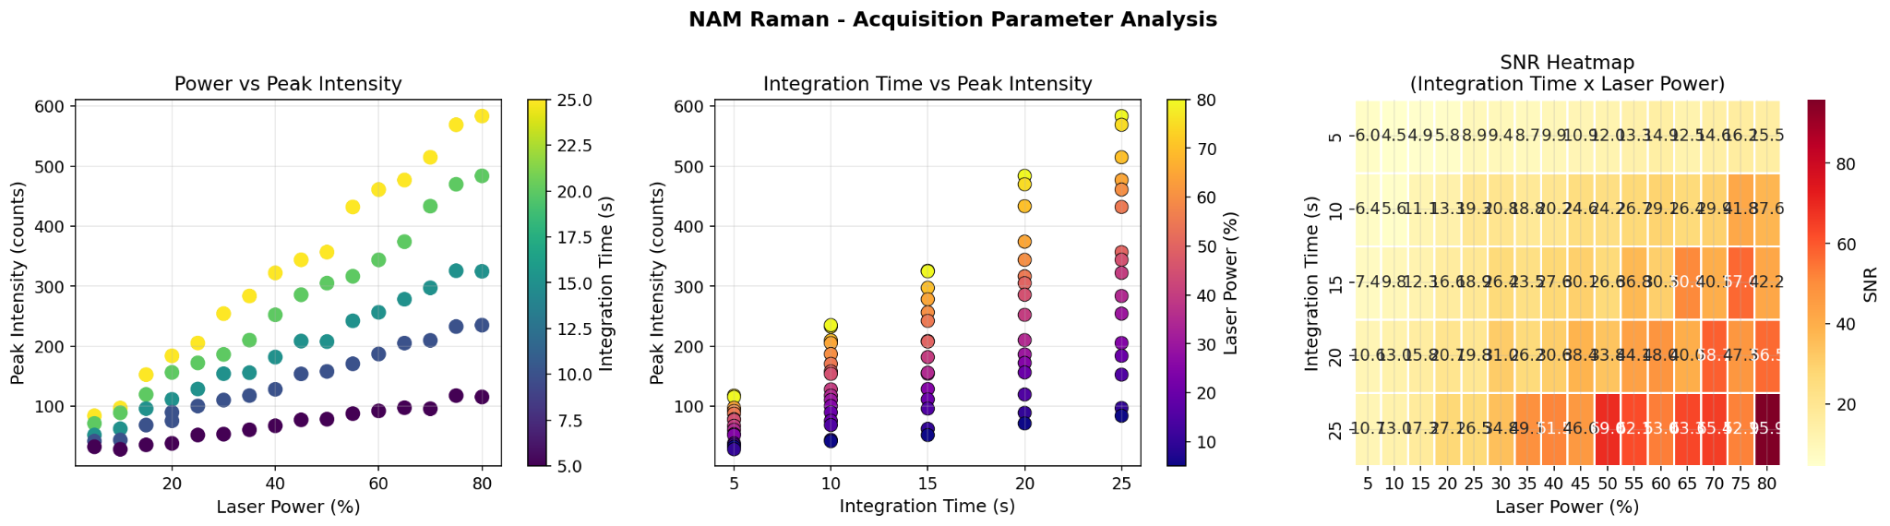
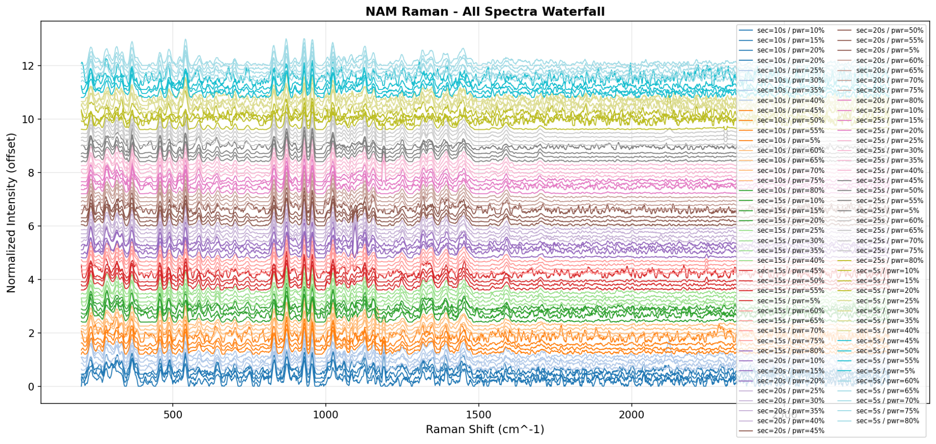
Acquisition Parameter Analysis

Slide 19
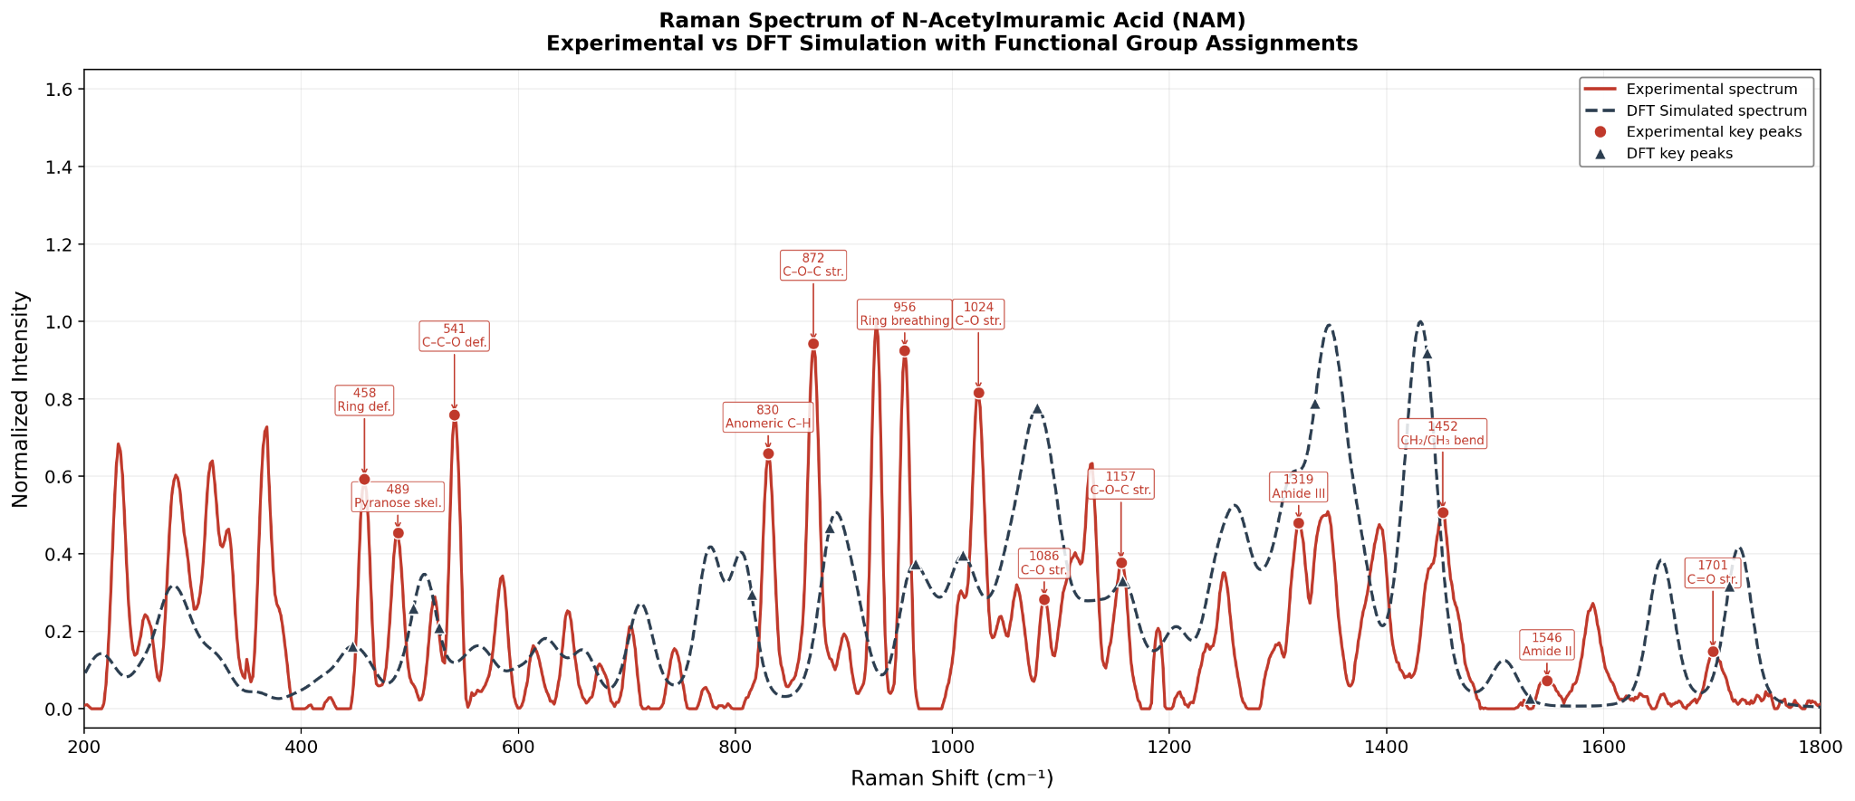
Raman Peak Assignments
Raman Shift | Assignment
1701 | C=O stretch
1546 | Amide II
1452 | CH₂ bending
1086 | C–O stretch
872 | C–O–C stretch
956 | Pyranose ring breathing
C=O stretch
C–O stretch

Slide 20
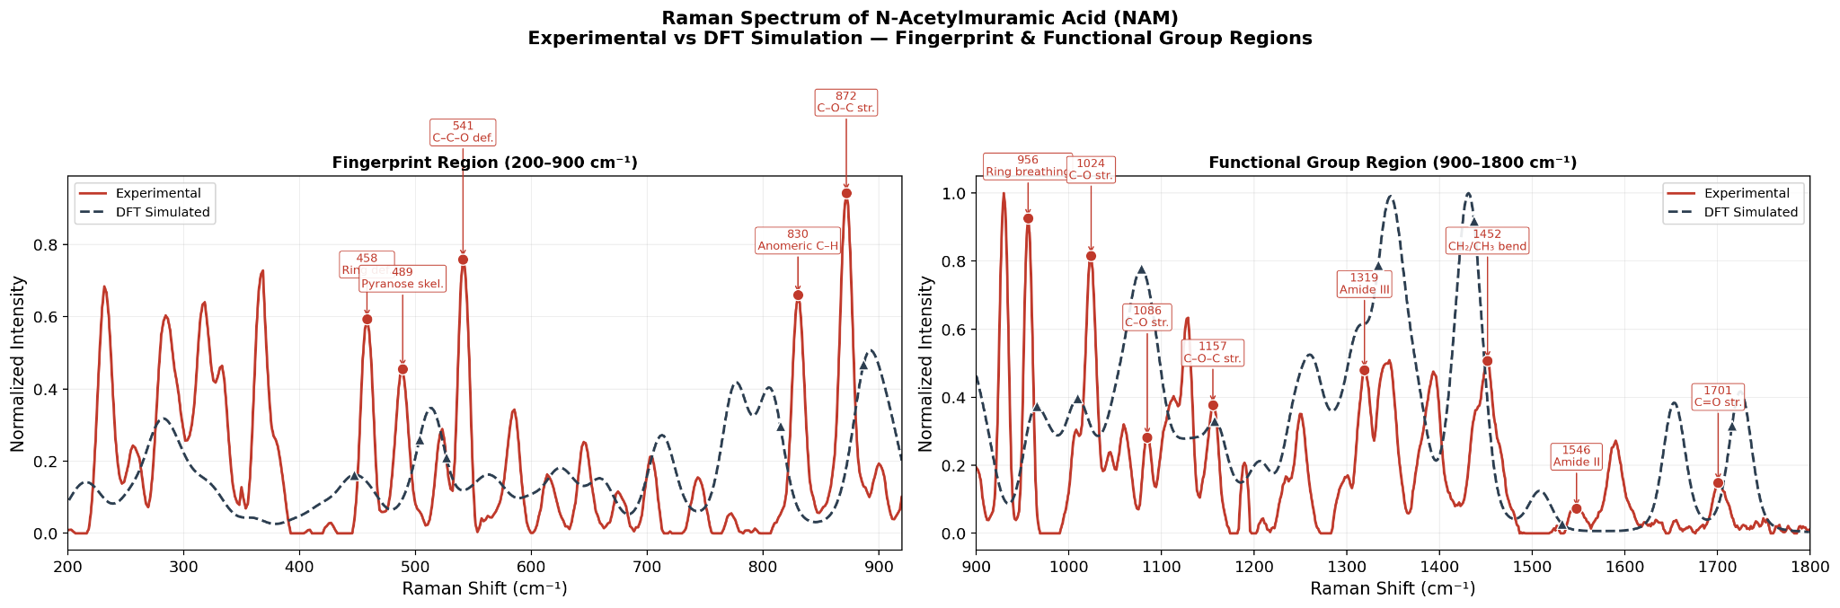
Structural Interpretation
Key findings:
Strong agreement between experimental and DFT spectra
Raman peaks clearly identify functional groups
DFT accurately predicts vibrational frequencies
Raman spectrum confirms presence of:
Amide Group
1546 cm⁻¹ 1319 cm⁻¹
Carbohydrate Backbone
1157–1024 cm⁻¹
Glycosidic Linkage
872 cm⁻¹ 830 cm⁻¹
Pyranose Ring
541 cm⁻¹ 489 cm⁻¹ 458 cm⁻¹

Slide 21
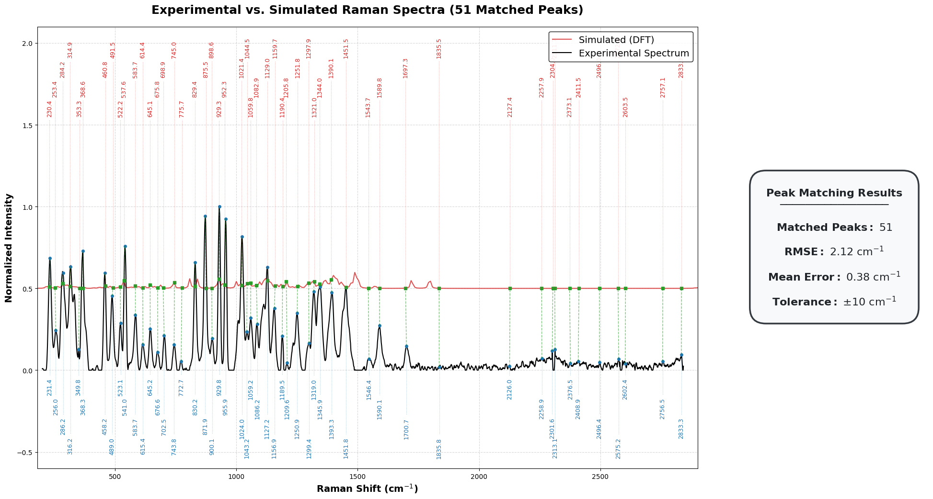
Experimental vs DFT Raman Spectrum (NAM)
Excellent agreement between experiment and simulation (RMSE ~2 cm⁻¹) validates DFT for biomarker detection

Slide 22
Part III: Lipoteichoic Acid
Challenge in LTA Simulation
LTA is a large polymeric biomolecule
Full DFT simulation → computationally impractical
Need a scientifically valid alternative approach
Component-Based Modeling Strategy
Decompose LTA into representative molecular units
Simulate each component using DFT
Combine spectral contributions to reconstruct LTA fingerprint
“Fragment-based modeling is a standard approach for large biomolecules”

Slide 23
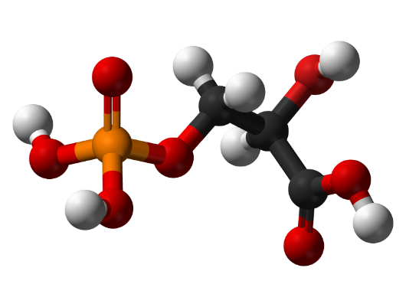
Modeling the LTA Fragment
Simplifying the Polymer
→
We isolated a representative glycerol-phosphate fragment containing two repeating units.
→
This fragment successfully preserves the local chemical environment responsible for key Raman-active backbone vibrations.

Slide 24
Structure of Lipoteichoic Acid
Lipoteichoic acid consists of three structural components:
• Glycolipid membrane anchor • Poly(glycerol–phosphate) backbone • Substituent groups such as D-alanine residues or sugars
The backbone is composed of repeating units:
glycerol – phosphate – glycerol – phosphate
Typical LTA molecules contain 10–20 repeating glycerol–phosphate units, producing large polymers with hundreds of atoms.
Because the full polymer is computationally expensive for quantum simulations, smaller molecular fragments are often used to represent the local chemical environment responsible for Raman-active vibrations.

Slide 25
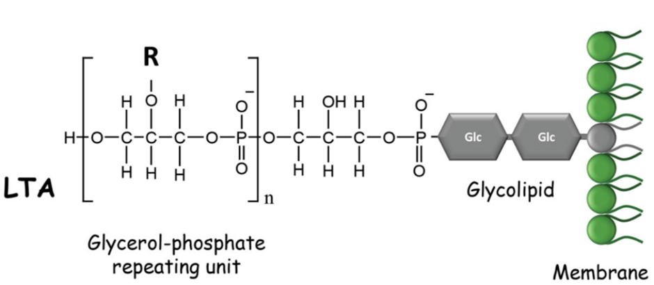
Lipoteichoic acid (LTA) is a key structural component of Gram-positive bacterial cell walls. It is anchored to the membrane through a glycolipid and extends outward as a polymer of repeating glycerol–phosphate units.
General structure:
Lipid anchor – (Gro–P)ₙ
where:
Gro = glycerol P = phosphate
LTA contributes to:
bacterial adhesion
cell wall maintenance
activation of host immune responses through receptors such as Toll-like receptor 2

Slide 26
Raman Spectroscopy and DFT
Raman spectroscopy is a vibrational technique that provides molecular fingerprints based on characteristic vibrational modes.
Advantages:
label-free detection
minimal sample preparation
useful for identifying bacterial components
However, experimental Raman spectra often contain overlapping bands and complex vibrational couplings.
To improve interpretation, Density Functional Theory (DFT) simulations are used to:
calculate vibrational frequencies
determine Raman activities
assign experimental bands to specific molecular vibrations
Objective of this work
Model a glycerol–phosphate fragment representing the LTA backbone
Calculate its Raman spectrum using DFT
Identify characteristic vibrational modes of phosphate and glycerol groups

Slide 27
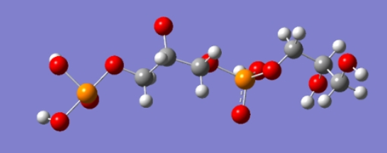
Molecular Fragment and Structure Construction
To model the LTA backbone, a representative glycerol–phosphate fragment containing two repeating units was used:
HO–CH₂–CH(OH)–CH₂–O–PO₃–O–CH₂–CH(OH)–CH₂–OH
Key functional groups included:
The structure was generated using Avogadro from the SMILES string:
OP(=O)(O)OCC(O)COP(=O)(O)OCC(O)CO
The molecule was then geometry optimized using the Universal Force Field (UFF) to obtain a reasonable starting structure before quantum calculations.
Functional Group | Role in Raman Spectrum
Phosphate (PO₄) | Strong Raman-active vibrations
C–O–P linkage | Backbone vibrational modes
Hydroxyl groups | Hydrogen bonding interactions
Glycerol backbone | Carbon–oxygen vibrations

Slide 28
DFT Simulation Method
Quantum-chemical calculations were performed using Gaussian 16.
The simulation included:
• geometry optimization • vibrational frequency calculation • Raman activity calculation
Parameter | Value
Functional | B3LYP
Basis set | 6-31G(d)
Solvent model | SMD (water)
Gaussian keywords used:
# B3LYP/6-31G(d) Opt Freq Raman SCF=Tight Int=UltraFine SCRF=(SMD,Solvent=Water)
Explanation:
SCF=Tight ensures strict electronic convergence
Int=UltraFine improves numerical accuracy
SCRF=SMD models the aqueous environment in which LTA normally exists
DFT frequencies typically overestimate vibrational frequencies, so a scaling factor is applied.
Scaled frequency = frequency × 0.96

Slide 29
Raman Spectrum and Vibrational Assignments
The DFT calculation produced Raman-active vibrational modes corresponding to motions of the phosphate groups and glycerol backbone.
Raman Shift (cm⁻¹) | Assignment
481 | O–P–O bending
922 | P–O–C stretching
1291 | O–H deformation
3046–3091 | C–H stretching
3712 | O–H stretching
Most characteristic information appears in the fingerprint region (500–1500 cm⁻¹) where phosphate-related vibrations dominate.
Interpretation:
481 cm⁻¹ → phosphate bending vibration
922 cm⁻¹ → phosphate ester stretching
1291 cm⁻¹ → hydroxyl deformation
3046–3091 cm⁻¹ → glycerol C–H stretching
3712 cm⁻¹ → weakly hydrogen-bonded O–H stretching

Slide 30
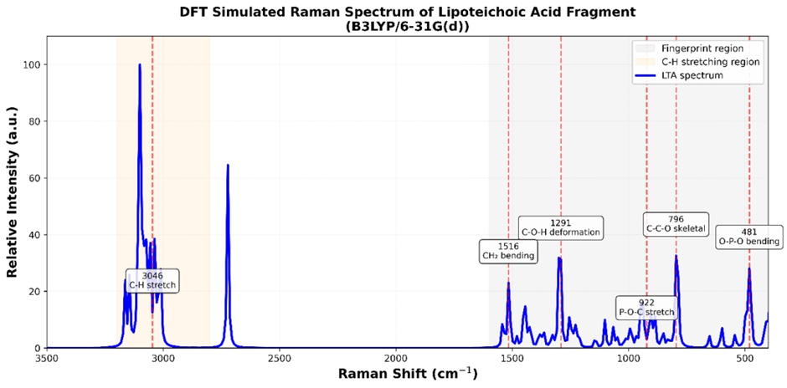

Slide 31
Limitations
The model represents only a small fragment of lipoteichoic acid and does not include:
lipid anchors
substituent groups
full polymer chain
Therefore, the simulated spectrum mainly reflects backbone vibrations.
Conclusion
DFT simulations successfully reproduced the Raman vibrational modes of a glycerol–phosphate fragment representing the LTA backbone.
Key findings:
strong Raman bands originate from phosphate bending and stretching modes
glycerol backbone contributes to C–H and O–H vibrations
DFT calculations provide a useful tool for interpreting Raman spectra of bacterial cell wall components
This approach helps improve spectroscopic identification of bacterial biomarkers.

Slide 32
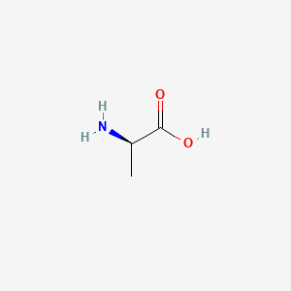
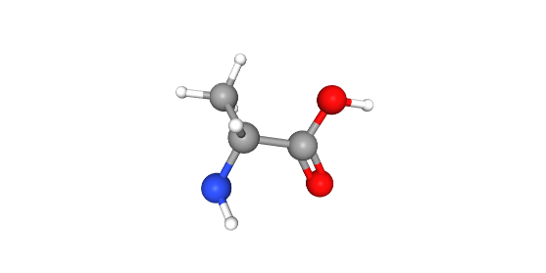
Modeling the LTA Substituent: D-Alanine
Why D-Alanine?
• Represents amino substituent in LTA • Responsible for surface charge regulation • Important for Gram-positive bacterial identification
Molecular Characteristics
2D Structure
• Exists in zwitterionic form: NH₃⁺ – COO⁻ • Contains:
Amino group
Carboxylate group
Methyl group
DFT Simulation Method
• Geometry optimization + Raman calculation • Functional: B3LYP • Basis set: 6-31G(d) • Solvent: SMD (water)
3D Structure

Slide 33
Key Raman Vibrations
Raman Shift (cm⁻¹) | Assignment
~1500 | NH₃⁺ symmetric deformation
~1560–1600 | COO⁻ stretching
~1440 | CH₃ deformation
~1200 | C–N stretching
Interpretation
• NH₃⁺ and COO⁻ peaks confirm zwitterionic amino acid • Provides amino signature in LTA spectrum
Conclusion
D-Alanine contributes amino vibrational features, especially in the 1500–1600 cm⁻¹ region, enabling identification of amino substituents in LTA.

Slide 34
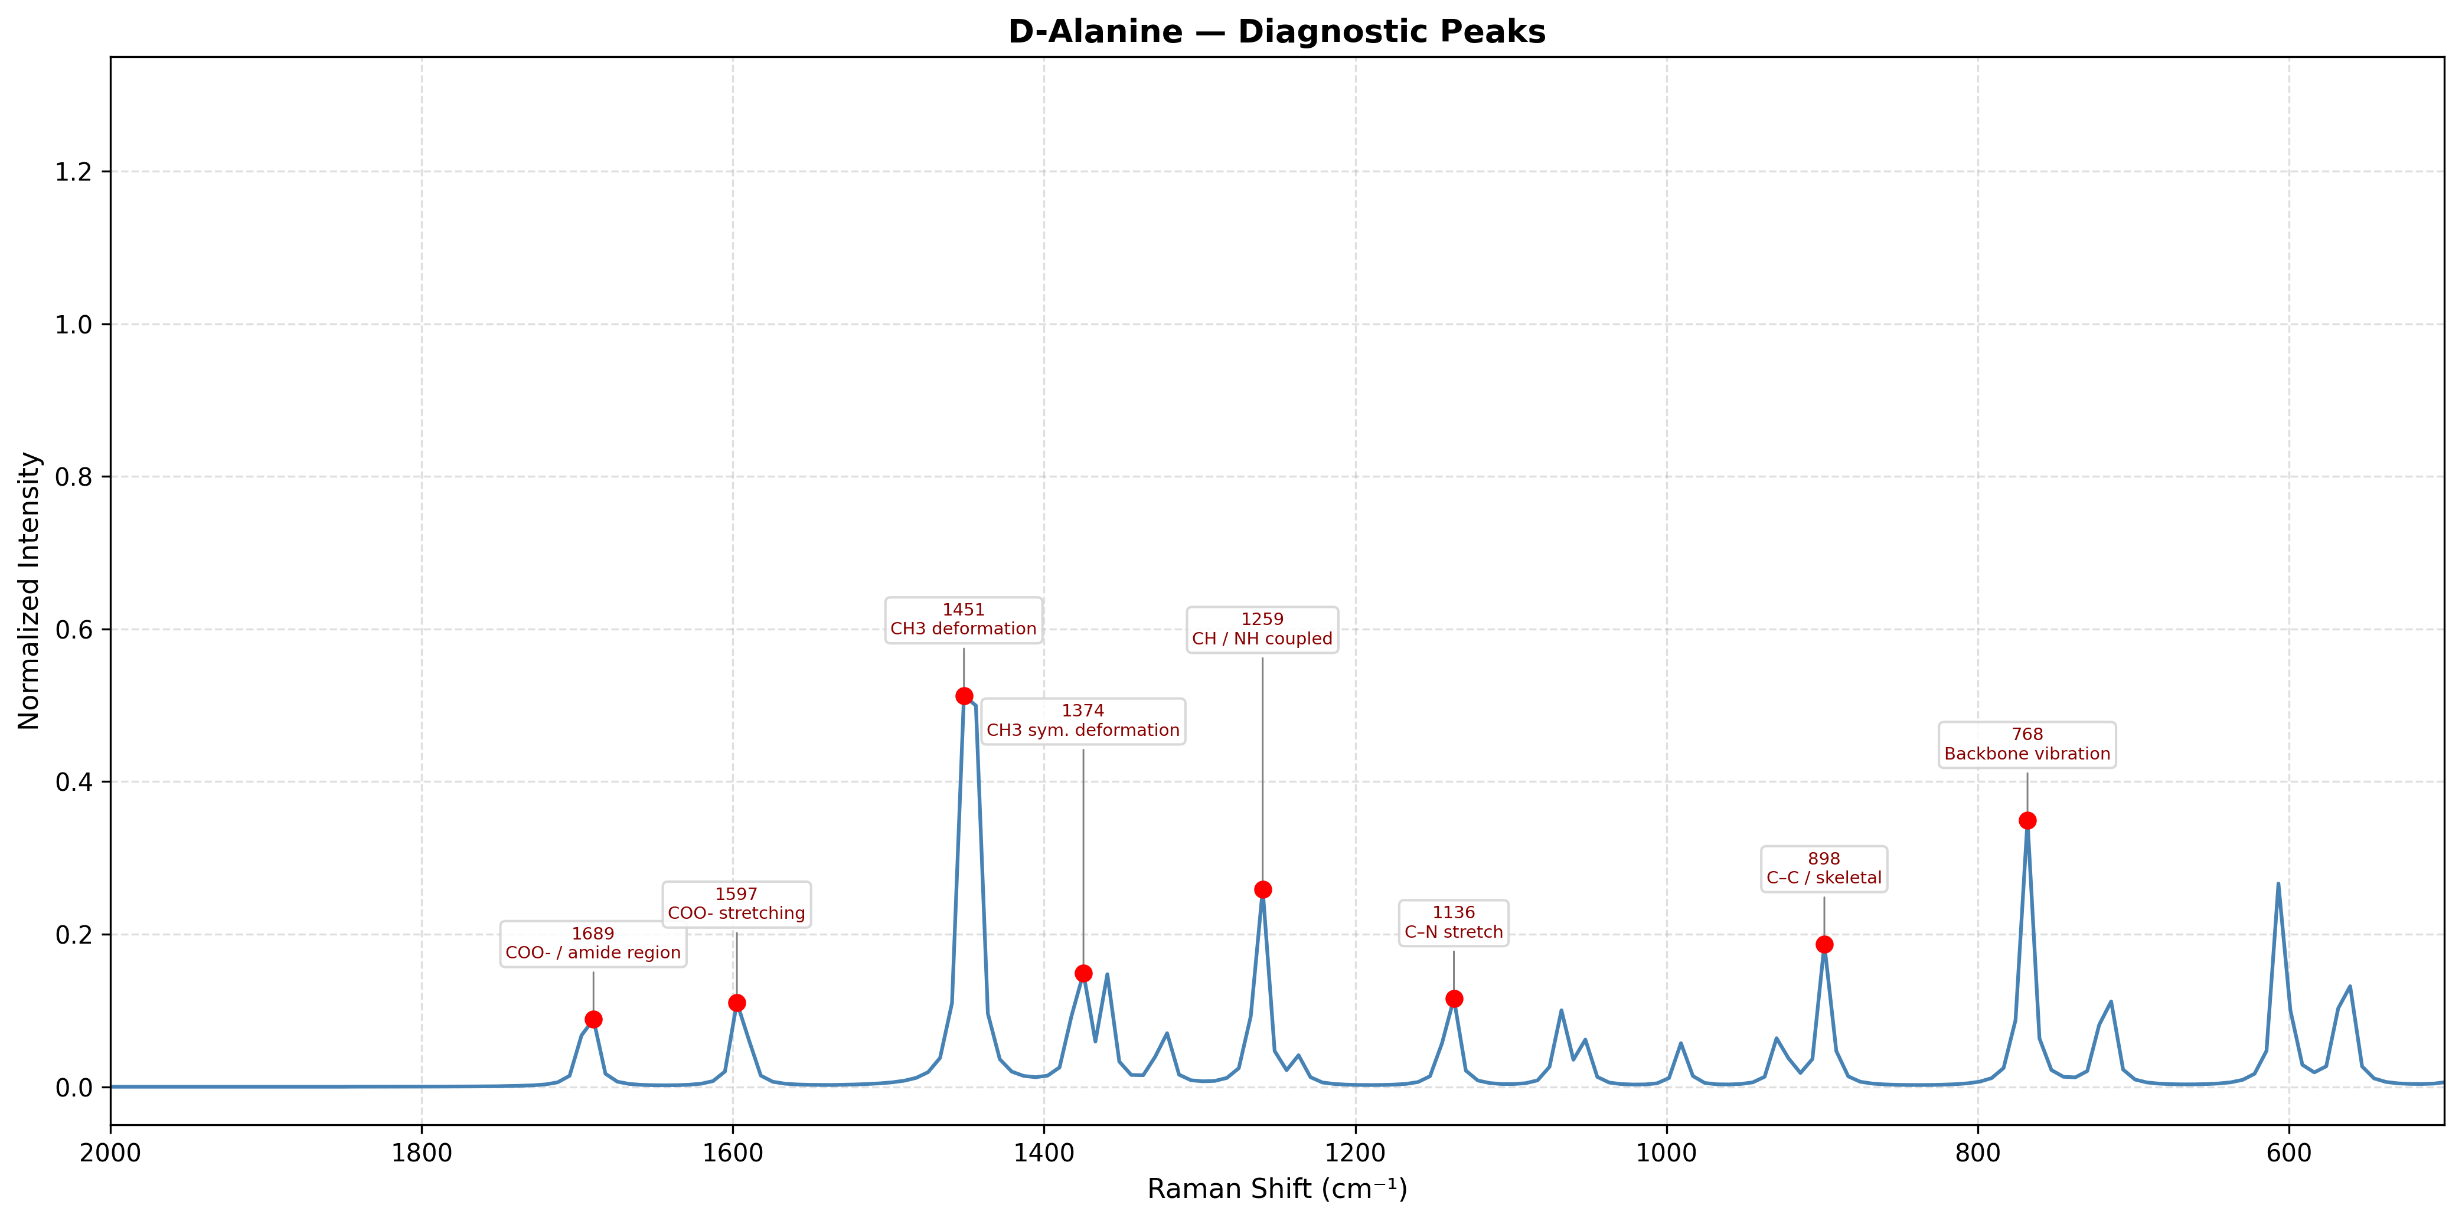

Slide 35
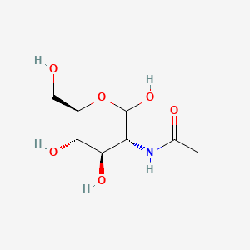
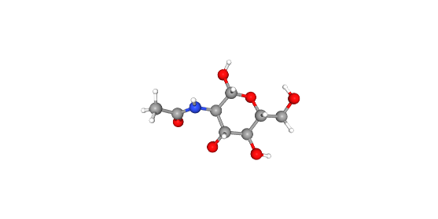
Modeling the LTA Substituent: GlcNAc
Why GlcNAc?
• Represents carbohydrate component • Present in bacterial cell wall structures • Provides strong Raman-active sugar signals
Molecular Characteristics
2D Structure
• Pyranose ring structure • Contains:
Multiple hydroxyl groups (–OH)
Acetamide group (–NHCO–)
C–O–C linkages
DFT Simulation Method
• Geometry optimization + Raman calculation • Functional: B3LYP • Basis set: 6-31G(d) • Solvent: SMD (water)
3D Structure

Slide 36
Key Raman Vibrations
Raman Shift (cm⁻¹) | Assignment
~900–1100 | C–O–C stretching
~1250–1300 | Amide III
~1650 | Amide I
~2800–3000 | C–H stretching
Interpretation
• Strong carbohydrate fingerprint region (900–1100 cm⁻¹) • Amide peaks confirm acetyl functionality
Conclusion
GlcNAc contributes carbohydrate and amide signatures, forming a major part of the LTA Raman fingerprint.

Slide 37
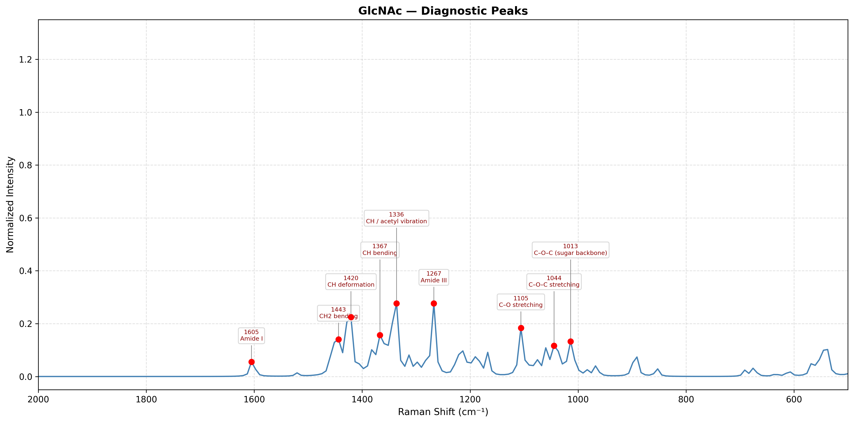

Slide 38
Raman Spectroscopic Analysis of Lipoteichoic Acid (LTA)
Content:
Sample: Lipoteichoic Acid (LTA) from Staphylococcus aureus
Technique: Raman Spectroscopy (785 nm laser)
Objective:
To identify functional groups of LTA
To compare experimental spectra with expected molecular regions
Approach:
Power variation study (40%, 50%, 60%, 70%)
Baseline correction + smoothing

Slide 39
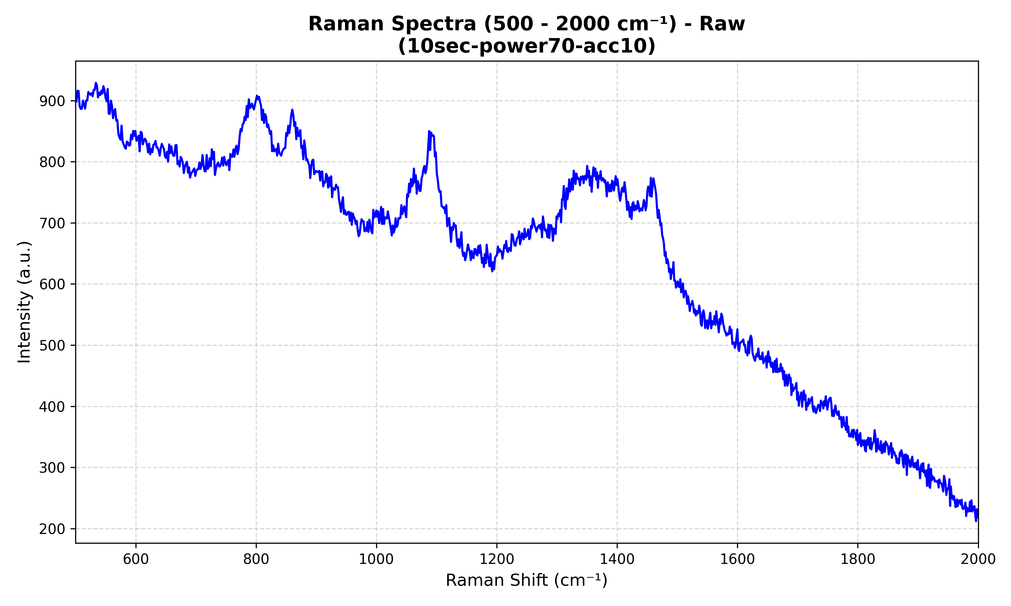
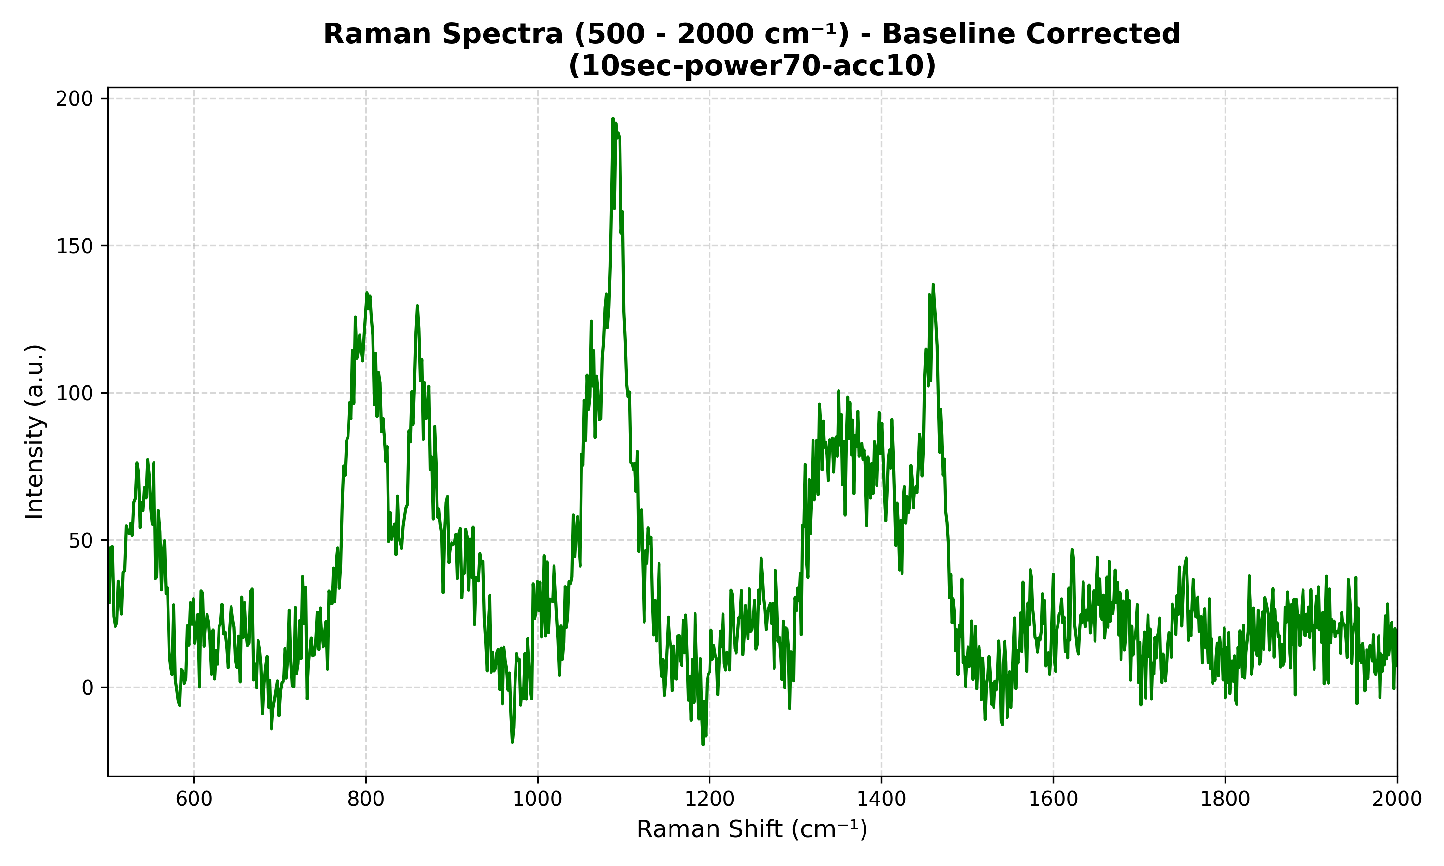
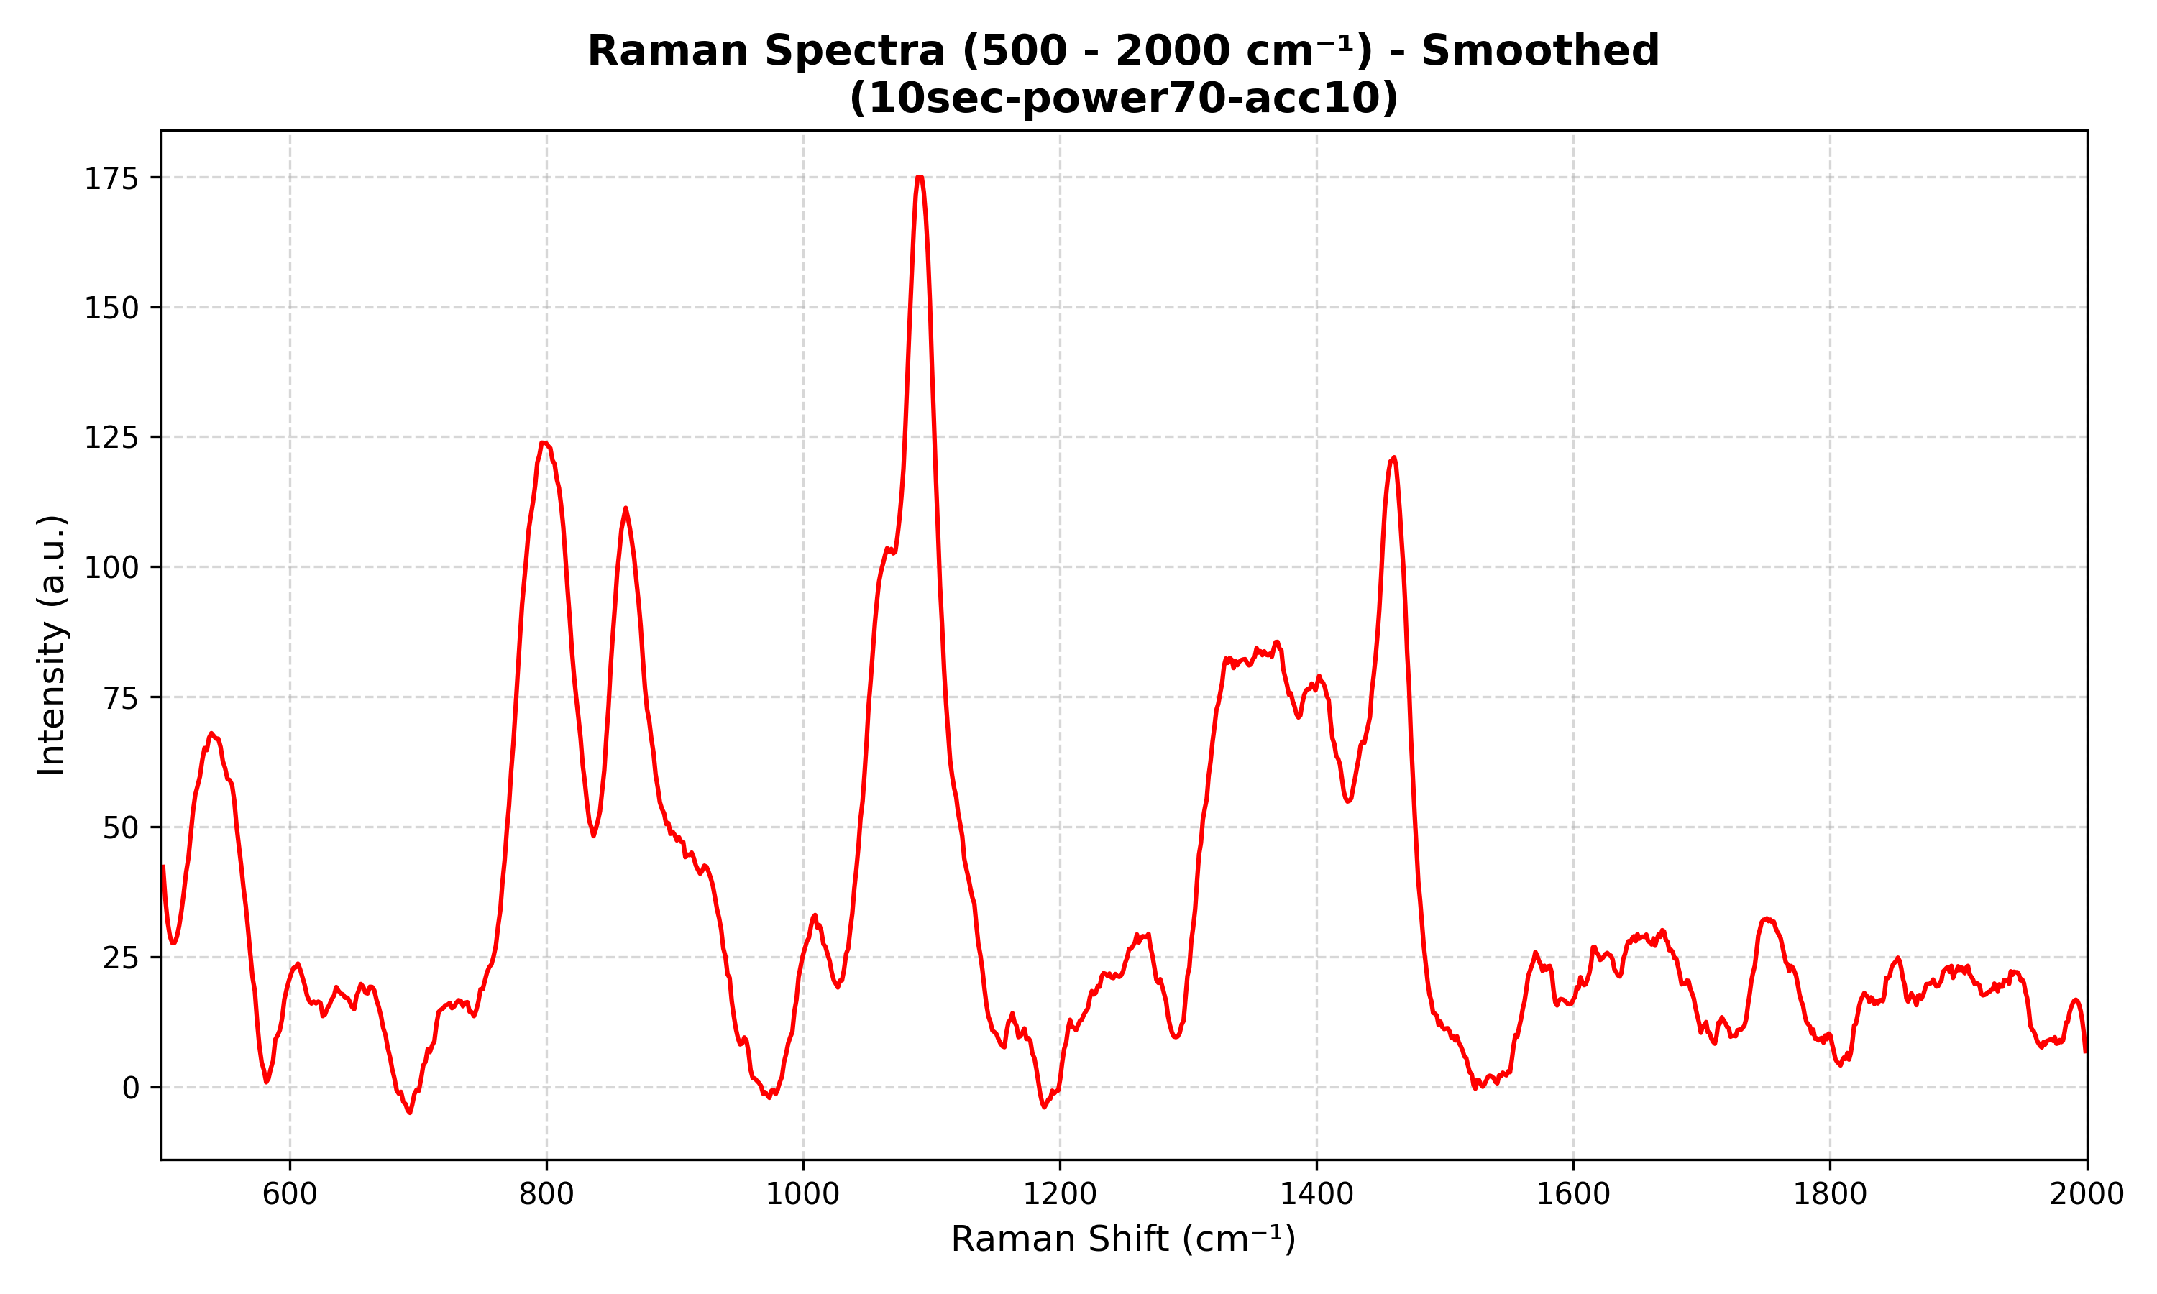
Experimental Methodology & Data Processing
Content:
Raman spectra collected in 500–2000 cm⁻¹ region
Instrument parameters:
Integration time: 10 sec
Accumulations: 10
Laser power: 40%, 50%, 60%, 70%
Data Processing Steps:
Dark subtraction
Baseline correction (ALS method)
Smoothing (Savitzky–Golay filter)
Visualization:
Functional regions highlighted using color-coded bands
Region-based interpretation instead of exact peak assignment

Slide 40
Functional Region Identification (LTA Components)
Region (cm⁻¹) | Assignment | Component
700–900 | P–O–C vibration | Phosphate backbone
900–1100 | C–O–C + PO stretch | Carbohydrate (GlcNAc)
1200–1300 | Amide III | GlcNAc acetyl group
1400–1500 | CH₃ deformation | D-Alanine
1500–1650 | Amide / NH₃⁺ / COO⁻ | Amino + peptide region
These regions correspond to key structural components of LTA

Slide 41
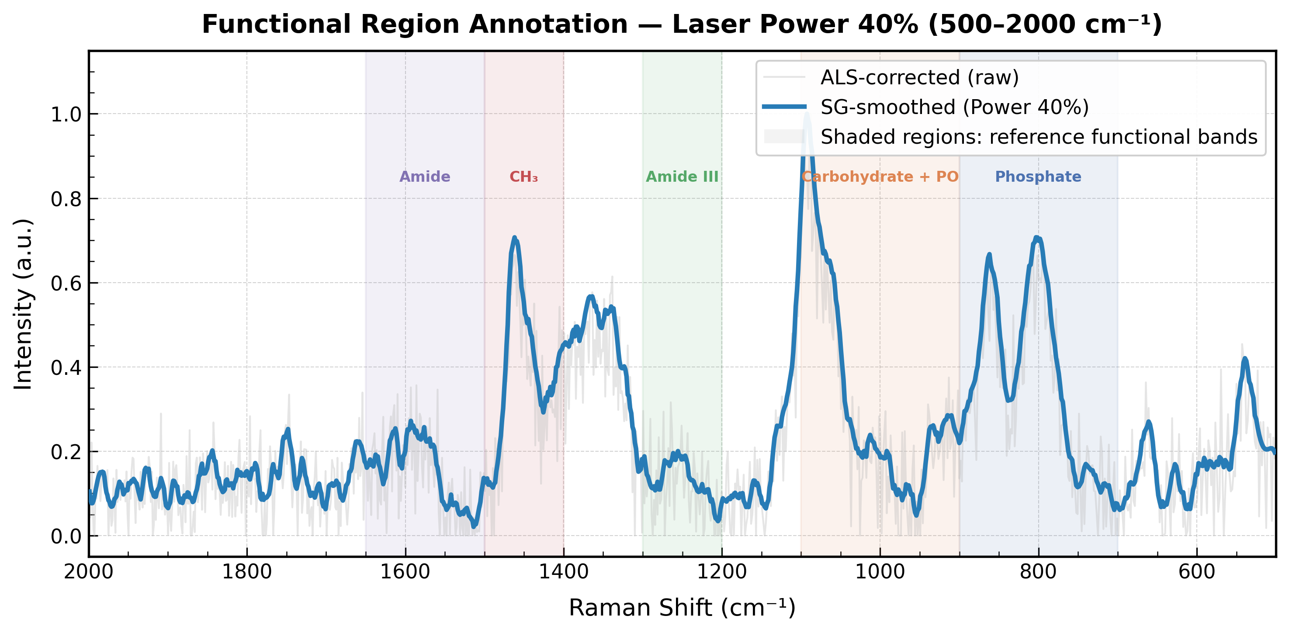
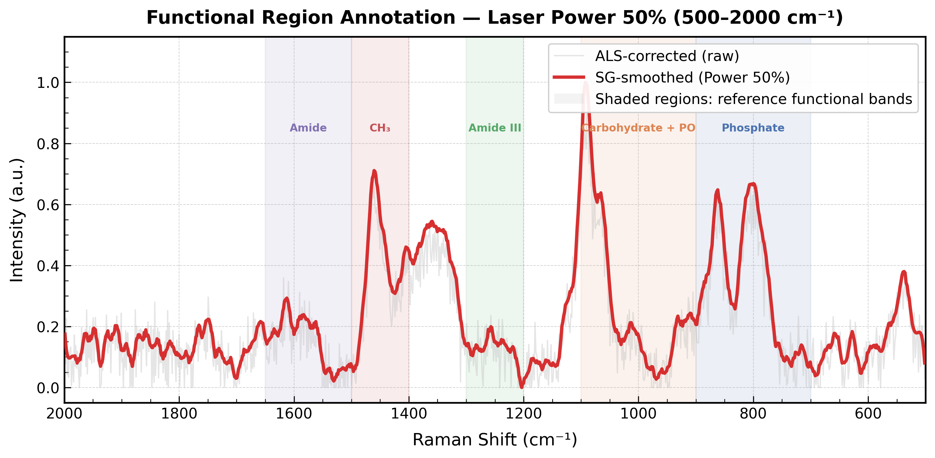
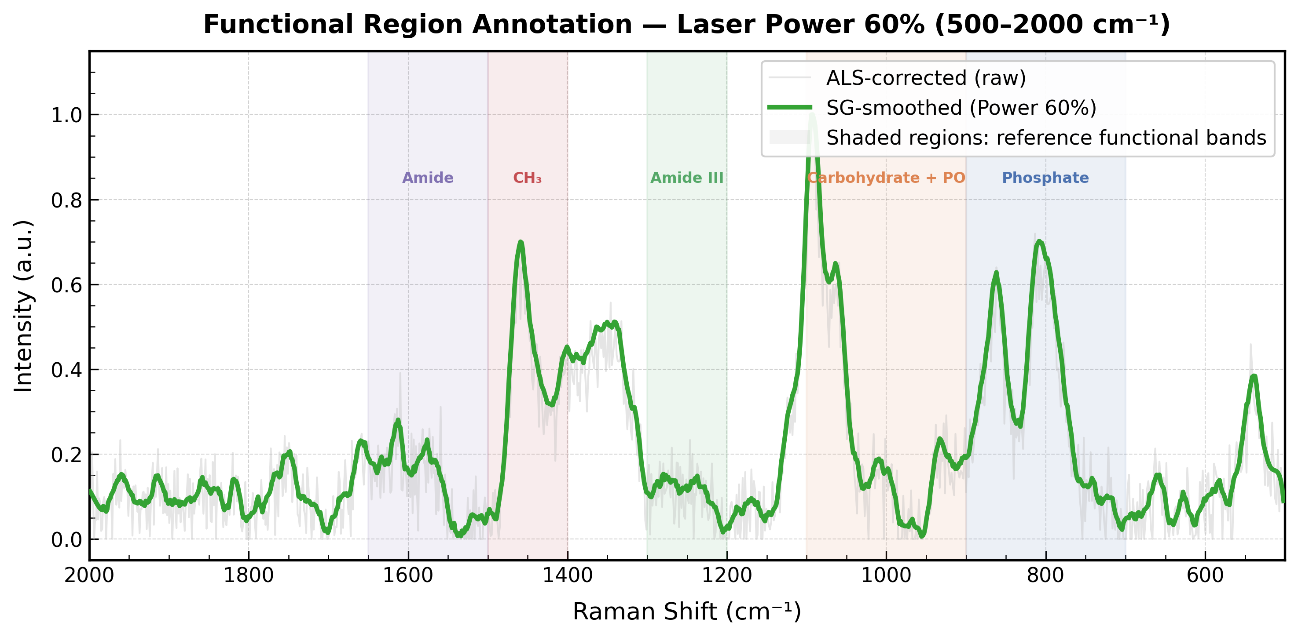
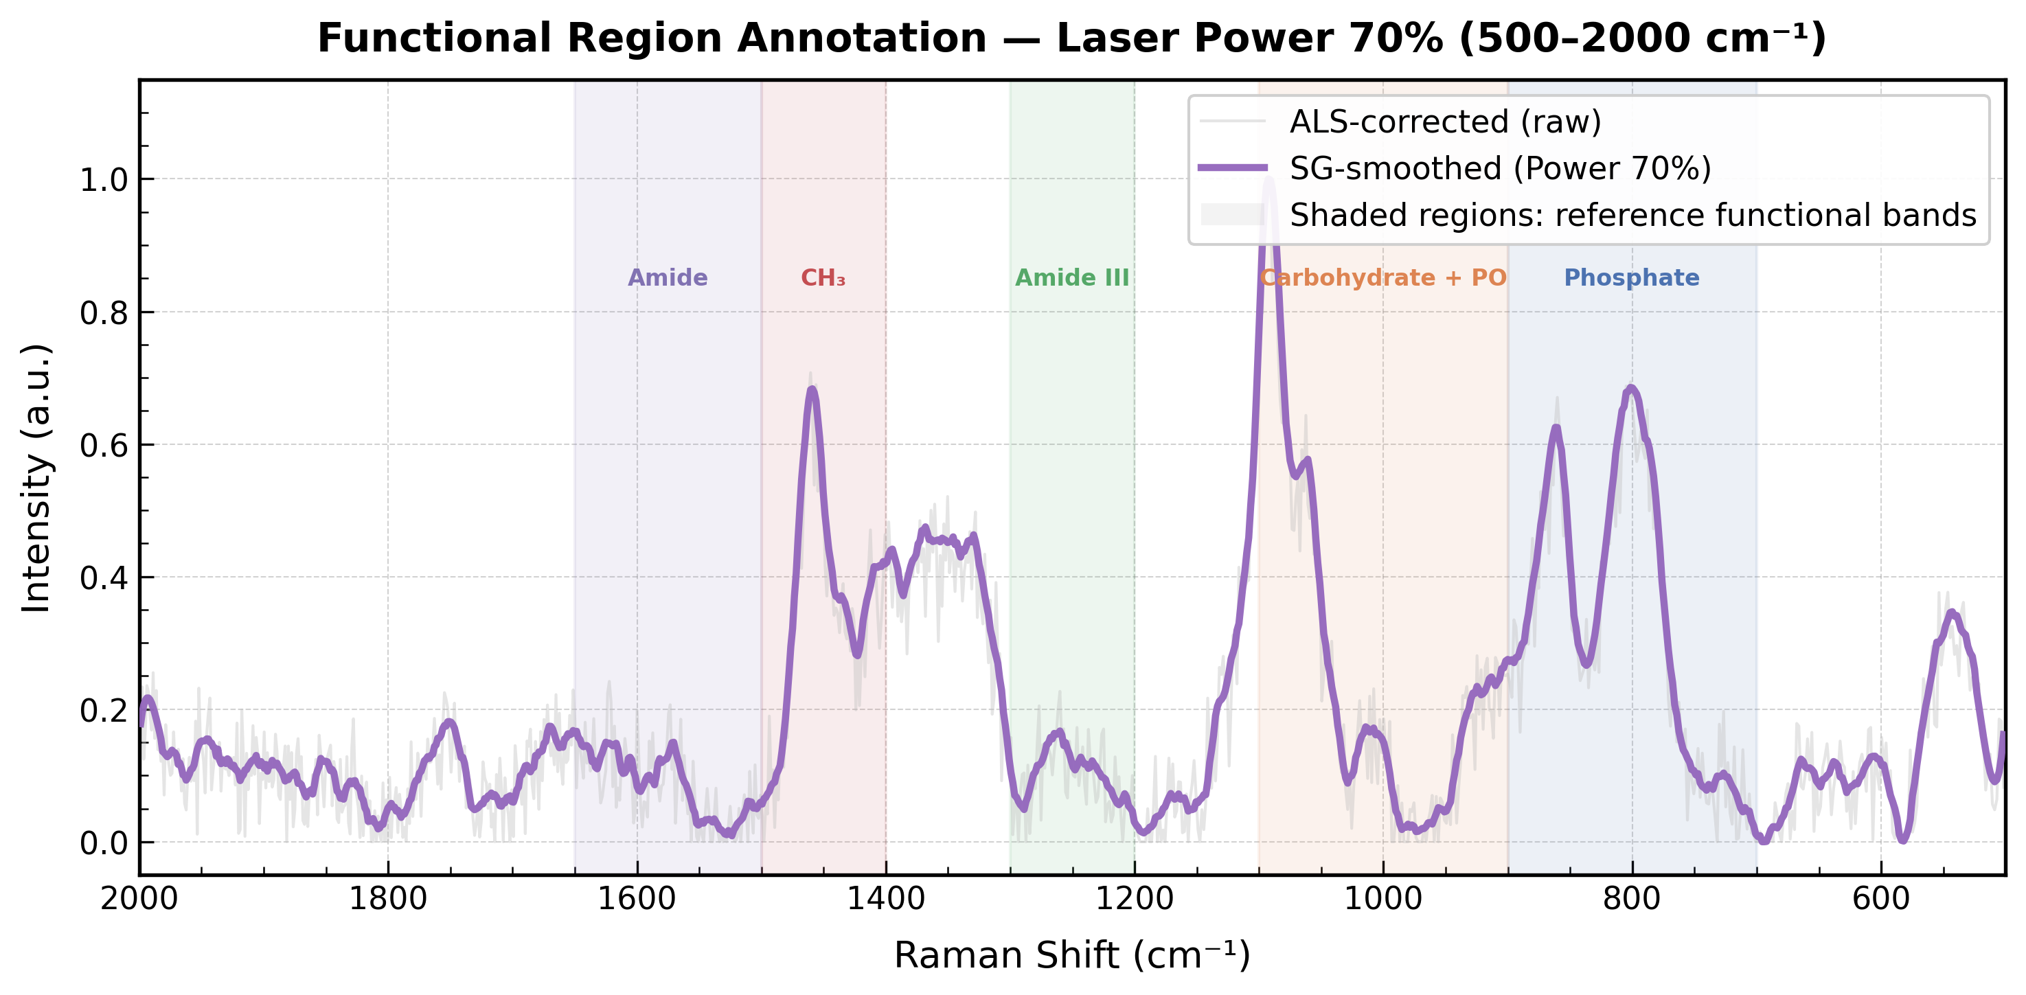

Slide 42
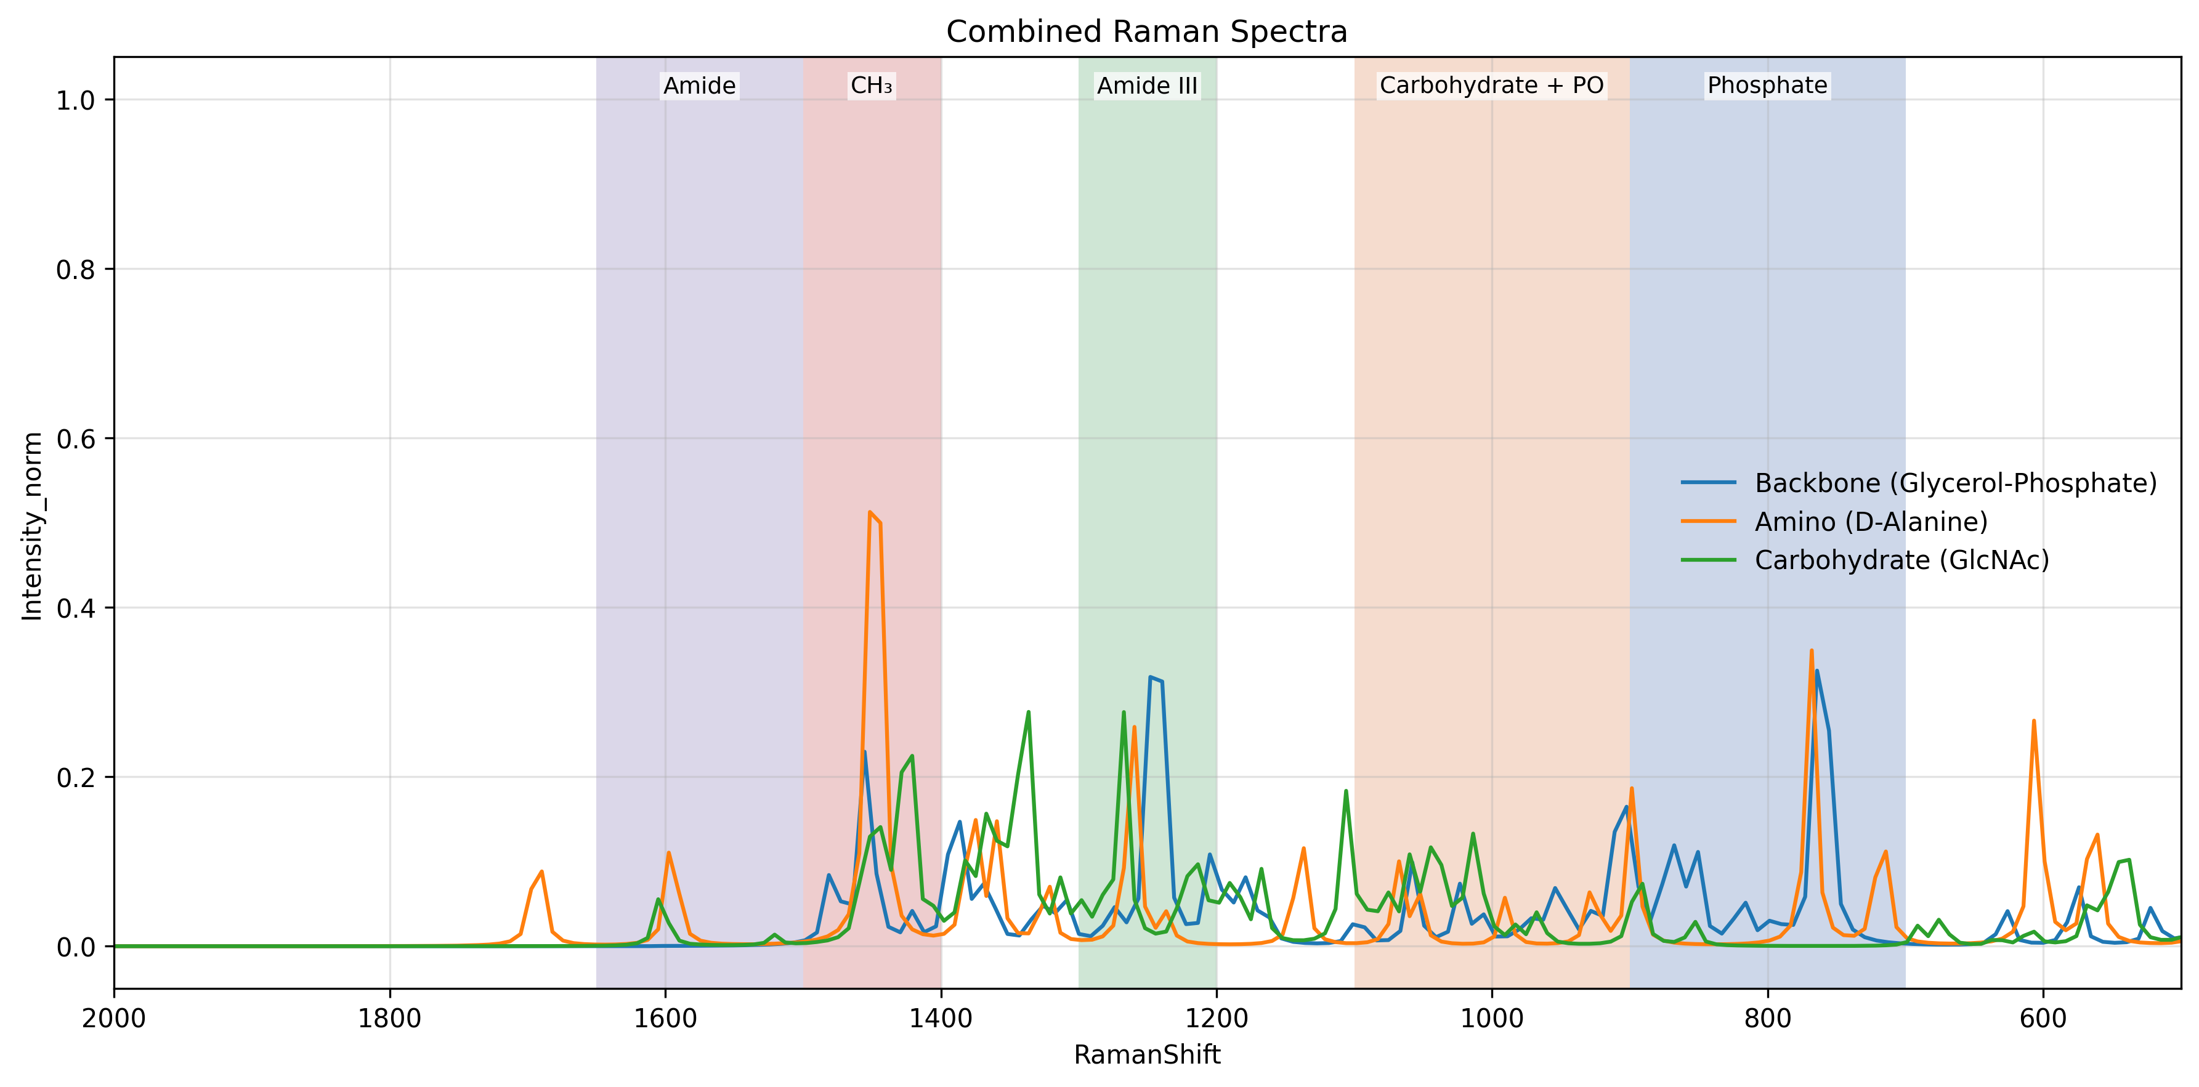
Experimental Data
Simulation Data

Slide 43
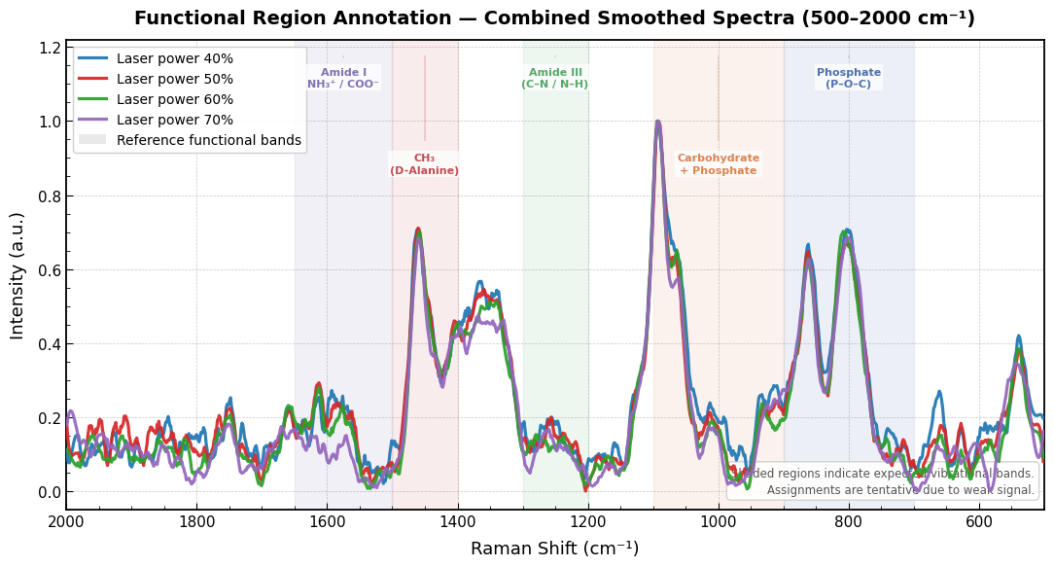
Observations from Raman Spectra
All spectra show broad and overlapping peaks
Key regions are present but not sharply resolved
Strong signal observed in:
~1100 cm⁻¹ → phosphate/carbohydrate region
~800–900 cm⁻¹ → phosphate backbone
Moderate signal in:
~1400–1500 cm⁻¹ → CH₃ (D-Alanine)
Weak/merged signal in:
Amide regions (1200–1300, 1500–1650 cm⁻¹)
Indicates presence of LTA functional groups but low peak resolution

Slide 44
Conclusion & Interpretation
Content:
Functional regions of LTA were successfully identified
Experimental spectra show:
1.Broad peaks due to complex biomolecule structure
2.Overlapping contributions from multiple components
Region-based analysis confirms:
Phosphate backbone
Carbohydrate structure
Amino acid (D-Alanine) presence
Limitation:
Peaks are not sharp due to:
Weak Raman scattering
Sample form (powder)

Slide 45
Future Work & Next Steps
1. Experimental Extension (NAM)
• Serial dilution of NAM samples • Raman data collection at different concentrations • Study of signal variation with concentration
2. Quantitative Analysis
• Comparative analysis of peak intensity vs concentration • Evaluation of detection limits • Signal-to-noise variation across dilution levels
3. LTA Work
• Serial dilution of LTA samples • Raman data collection at different concentrations • Study of signal variation with concentration
4. LPS Work
• DFT simulation of LPS components (Lipid A / phosphate groups) • Identification of characteristic Raman peaks • Literature comparison for validation

Slide 46
Key Questions from Last Meeting
1. Detection vs Quantification
Question: Can Raman/SERS quantify bacteria or only detect presence? Answer: Raman/SERS primarily provides qualitative detection through molecular fingerprints. However, with calibration methods such as serial dilution and intensity–concentration mapping, it can be extended to semi-quantitative estimation of bacterial load.
2. Speed vs Culture
Question: How is Raman better than culture if culture provides accurate results? Answer: Culture methods typically take 48–72 hours, whereas Raman/SERS can provide results within minutes. Even if quantification is approximate, rapid detection enables early clinical decision-making, which is critical in acute conditions.
3. Infection Stage Estimation
Question: Can you determine whether infection is low or severe? Answer: Yes. By correlating Raman intensity with bacterial concentration, infection levels can be classified as low, medium, or high, providing an indication of disease severity.

Slide 47
4. Accuracy of Quantification
Question: How reliable is Raman-based quantification? Answer: Raman quantification can be challenging due to signal variability. However, with proper calibration and controlled experimental conditions, it can provide clinically useful approximate estimates.
5. Dead vs Alive Bacteria
Question: Raman detects dead bacteria as well—how do you address this limitation? Answer: Raman detects molecular signatures regardless of viability. To address this, time-dependent measurements can be used. If signal intensity increases over time, it indicates active bacterial growth rather than residual presence.
6. Growth Monitoring
Question: Can you track whether bacteria are multiplying? Answer: Yes. By acquiring Raman spectra at multiple time points (e.g., 0, 30, and 60 minutes), trends can be observed. Increasing intensity indicates active growth, while stable or decreasing intensity suggests inactive or controlled infection.

Slide 48
7. Predictive Modeling
Question: Can we build a model to estimate bacterial quantity? Answer: Yes. Models can be developed to map spectral features to concentration. Additionally, machine learning approaches such as regression or neural networks can improve prediction accuracy.
8. Clinical Usefulness
Question: How will this approach help clinicians? Answer: It provides rapid information on both the presence and approximate bacterial load, enabling clinicians to decide whether treatment is necessary and how aggressive it should be.
9. Importance of Quantification
Question: Why is quantification important clinically? Answer: Bacterial load correlates with disease severity. Low levels may not require antibiotics, whereas high levels indicate active infection requiring intervention. Therefore, quantification supports clinical decision-making.
10. Clinical Validation
Question: What level of estimation is useful for clinicians? Answer: This requires validation with clinicians to determine what level of accuracy is clinically actionable and what thresholds should guide treatment decisions.

Slide 49
Questions & Discussion
Thank you

